Slide 1
Spectrum solutions for IoT connectivity
Eric Fournier
ECC Chairman
eric.fournier@anfr.fr
The 7th Annual Internet of Things European Summit
18-19 May, Brussels

Slide 2
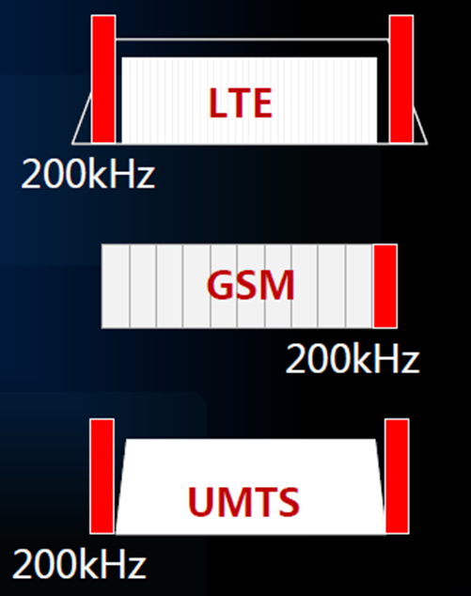
An horizontal solution: from 2G to 4G
LTE-based M2M (LTE-eMTC)
1.4 MHz and 3 MHz bandwidth
Narrowband M2M
EC-GSM-IoT and NB-IoT
200/180 kHz bandwidth
A new Work Item in ECC PT1
“To study the suitability of the current technical conditions
of harmonised MFCN bands for LTE-based M2M and NB M2M”
ECC Report 242 on IoT spectrum in the 733-736 MHz / 788-791 MHz band :
reluctance for dedicated spectrum + other usage of the band
no further action

Slide 3
An « ultimate » horizontal solution ? 5G
5G targets IoT market
5G features : network slicing, low energy consumption, scalability…
Lower frequency range for coverage, reliability, low latency ?
ITU-R M.2083-0
Ensuring that 5G can be introduced in existing bands
Including 3400-3800 MHz !
Issue of other bands with FDD channelling arrangements
WRC-19 agenda item 1.13 on 5G spectrum above 24 GHz
All bands proposed by Europe are in the list of bands to study
Many bands potentially for Europe : 31.8-33.4 GHz, 24.25-27.5 GHz, 40.5-43.5 GHz, 66-71 GHz …

Slide 4
Unlicensed bands for IoT
“user operated” : PAN, RFID, home automation …
“network operated” : Low Power Wide Area (Sigfox, LoRa, telemetry), Mesh networks, aeronautical/satellite ?
The new Eldorado : the 800/900 MHz band
ECC will define more flexible conditions in 862-870 MHz
ECC has defined « à la carte » harmonisation in 870-876 MHz and 915-921 MHz (existing users : Governmental, E-GSM-R)
915-921 MHz has potential for worldwide harmonisation
Partial but “mandatory” implementation for EU under discussion for beginning 2017 ?
Other bands : 169 MHz, 433 MHz, 2.45 GHz ..
A new band contemplated: 1900-1920 MHz

Slide 5
Spectrum solutions for vertical IoT ?
5795
5815
5855
5875
5905
5925
Transport
TTT
ITS NonSaf.
ITS Safety
ITS Ext.
ITS-G5 vs LTE-V2X
WAS/RLANs
Urban rails (CBTC)
Industry
Automation
Existing use in 2.45 GH and in 5725-5875 MHz (400 mW+DFS and DAA+ registration/notification)
“Wireless Industrial Automation requires an additional dedicated spectrum of 80 MHz in the range of 1,4 GHz to 6 GHz that is worldwide available”
1900-1920 MHz ?
Health
Medical Body Area Network in 2483.5-2500 MHz,
AMI in various bands

Slide 6
PMR solutions for IoT
Private Mobile Radio (80 MHz, 150 MHz, 400 MHz) has always provided solutions for metering for utilities (transport, energy …)
Moving to LTE/IoT ?
ECC work on 410-430 and 450-470 MHz for LTE/IoT
Shared IoT networks? National IoT platforms?
Remaining needs for specific narrowband PMR/IoT
Other usages : PMR, PPDR, radiolocation, governmental …
Other bands needed for PMR/IoT ?
VHF bands (47-88 MHz)
Bands higher than 1 GHz ?
Case of Railways :
future of GSM-R ?

Slide 7
For more information http://www.cept.org/ecc/

